Slide 1
Global Accessibility Awareness Day Trivia

Slide 2
What to expect:
Round 1: Disability History & Facts
Round 2: Notable Figures with Disabilities
Round 3: Disability and the Media
Round 4: Digital Accessibility
Round 5: Advancing Accessibility in Society
Round 6: Additional Questions Just For Fun

Slide 3
Round 1:
Disability History & Facts

Slide 4
The American with Disabilities Act (ADA) is the U.S. law that finally guaranteed equal rights for people with disabilities.
What year did the ADA become a law?
1936
1985
1990
2002

Slide 5
2. Which of the following is NOT a regulation that requires equal access:
The Americans with Disabilities Act
Section 504 & Section 508 of the Rehabilitation Act
CVAA - The 21st Century Communications and Video Accessibility Act
The Individuals with Disabilities Education Act
FCC Closed Captioning Regulations

Slide 6
3. What was the first international law to set a minimum standard for rights for people with disabilities?
Marrakesh Treaty
The Convention on the Rights of Persons with Disabilities (CRPD)
EU Mandate 376
The Americans With Disabilities Act

Slide 7
4. The Accessibility for Ontarians with Disabilities Act, or AODA, aims to identify, remove, and prevent barriers for people with disabilities.
What year did the AODA come about?
1979
1988
1990
2005

Slide 8
5. True or false?
People who are blind have no perception of light.

Slide 9
6. Men of Northern European ancestry are most likely to have color blindness. What percentage of those men have the most common form of color blindness (red-green)?
Less than 1%
2-4%
4-8%
9-12%

Slide 10
7. True or false?
Up to one million people in the world have some form of disability.

Slide 11
8. How many individuals worldwide have hearing loss?
Up to 100 million people
100-300 million people
300-500 million people
More than 500 million people

Slide 12
9. What is the difference between Open and Closed Captions?
Open captions can be edited by a user but closed captions cannot
Open captions do not have a background color. Closed captions always have a high contrast background color which makes them easier to read
Open Captions are “burned” into the video and always appear, but closed captions can be turned on and off by the user.
None of the above

Slide 13
10. True or false?
Current production of hearing aids meets over 60% of global need.

Slide 14
11. True or false?
A puff-and-sip adaptive controller is often used by an individual with limited motor skills (movement of body parts).

Slide 15
12. True or false?
Everyone is affected by disability at some time in their life.

Slide 16

TIME TO GRADE YOUR ROUND 1 ANSWERS!

Slide 17
Round 2:
Notable Figures with Disabilities

Slide 18
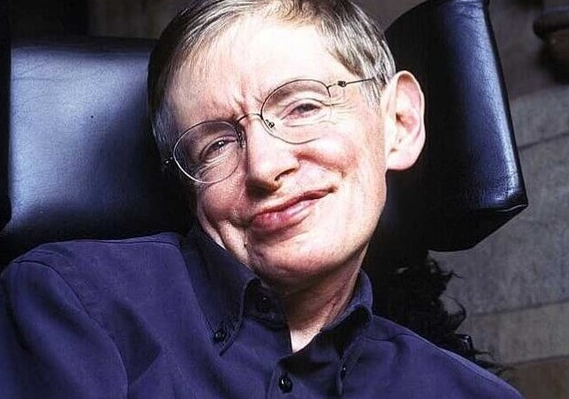
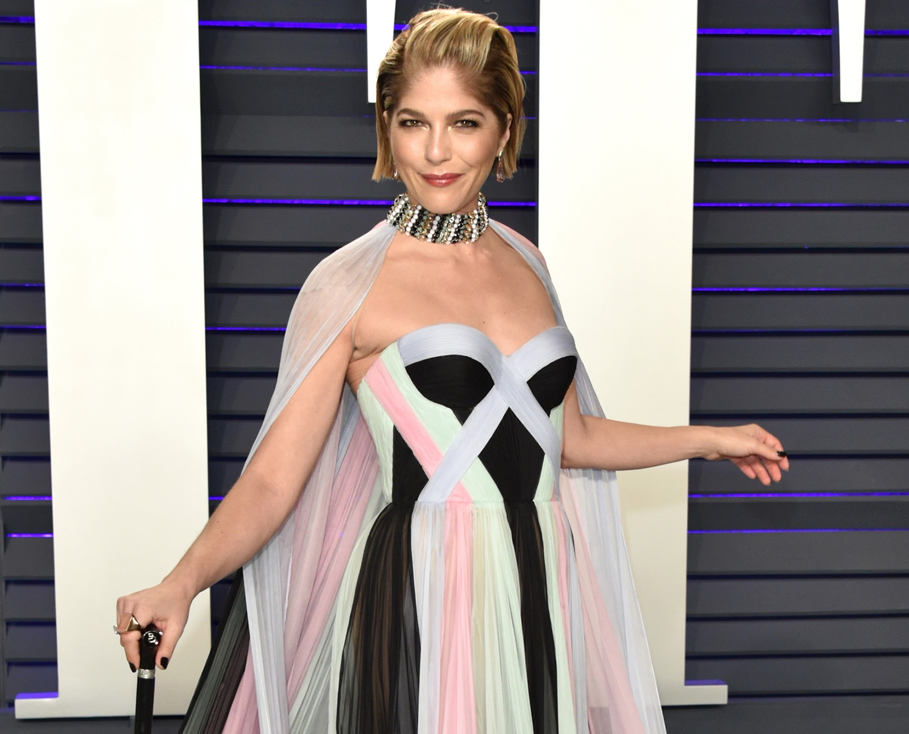
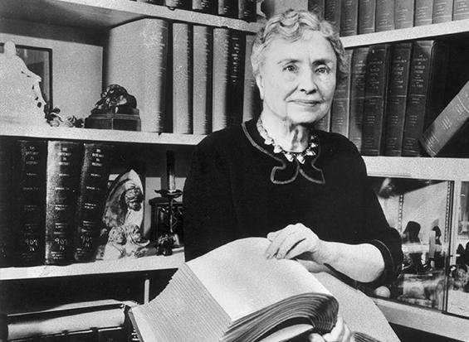
Notable figures, 1 through 3
1
2
3
Notes:
He was a Professor for Cambridge. He advanced our knowledge of general relativity and quantum gravity and has made enormous contributions in math, science, and physics while living with Amyotrophic lateral sclerosis (ALS), a rare nerve disorder that affects muscular strength, movement, and overall body function.
An actress best known for her roles in movies such as Cruel Intentions and Legally Blonde, she took to Instagram in October 2018 to tell her fans the news that she was diagnosed with Multiple Sclerosis in August 2018, after seeing a doctor for what she thought was a pinched nerve.
She was an American author, political activist, and lecturer. In 1882, At only 19 months old, she was diagnosed with meningitis which quickly left her unable to hear or see. Despite her disability, she learned to read and write and was the first deaf-blind person to earn a Bachelor of Arts degree.

Slide 19
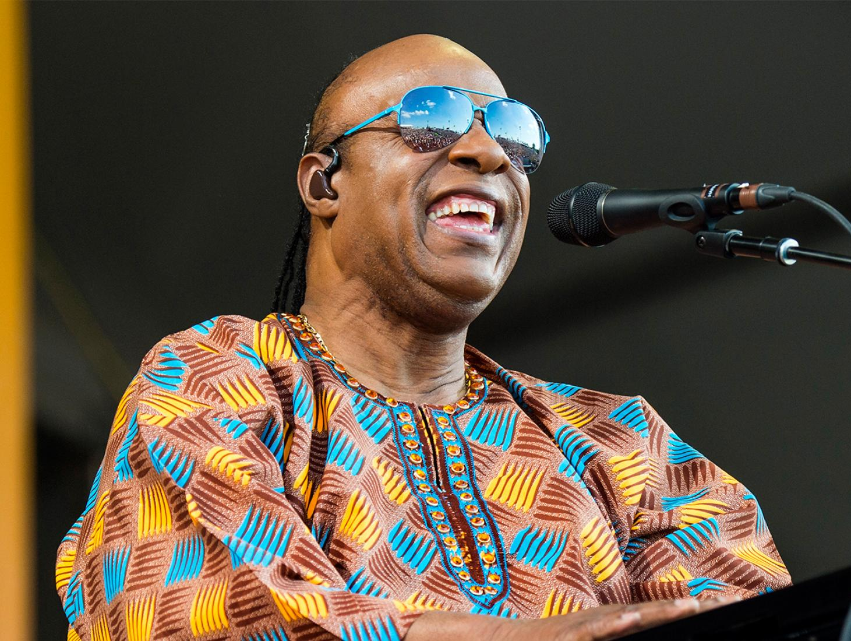
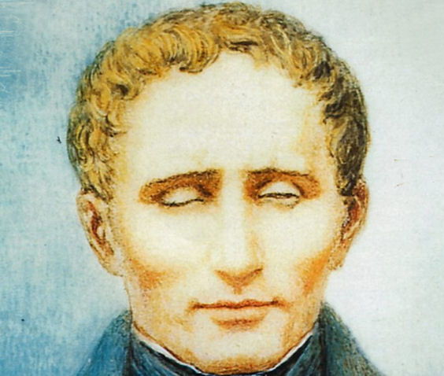

Notable figures, 4 through 6
4
5
6
Notes:
4. This blind pianist and musician revolutionized the genres of funk, jazz, and pop. Some may even say he created his own musical genres.
5. A French educator and inventor of a system of reading and writing for use by the blind or visually impaired. His system remains virtually unchanged to this day, and is known worldwide simply as braille.
6. This classical/baroque master knew how to intricately weave notes, scales, rests, and percussion together to make some of the most iconic pieces of music ever heard.. He had hearing loss and tinnitus (ringing in his ears) for most of his adult life, but was still able to create some of the most beautiful pieces of music ever composed.

Slide 20
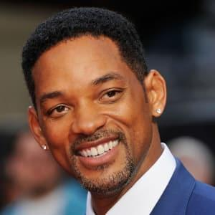
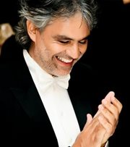
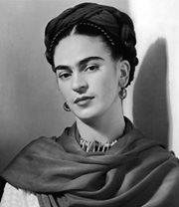
Notable figures, 7 through 9
7
8
9
Notes:
7. An American actor, rapper and media personality who has been nominated for five Golden Globe Awards and two Academy Awards, and has won four Grammy Awards. In an interview with Rolling Stone Magazine in 1998, he revealed that as a child, he had difficulties coping with his Attention Deficit Hyperactive Disorder (ADHD). He told the magazine that he was a “B” student who should’ve been getting “A’s.”
8. World-famous Tenor, musician, writer and musical producer of Italian origin, he has sold more than 75 million records. He was born with congenital glaucoma that left him partially blind and suffered a blow during a football game that left him completely blind.
9. She is a Mexican artist who acquired polio during her childhood and, according to some sources, also had spina bifida, which caused dysmetria (lack of coordination) in her right leg. She spent much of her life in bed with severe pain. Even so, she became a world-famous artist and icon of the twentieth century.

Slide 21
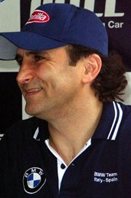
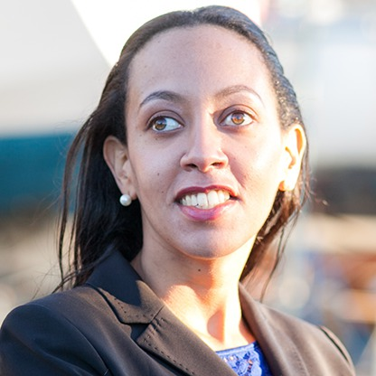
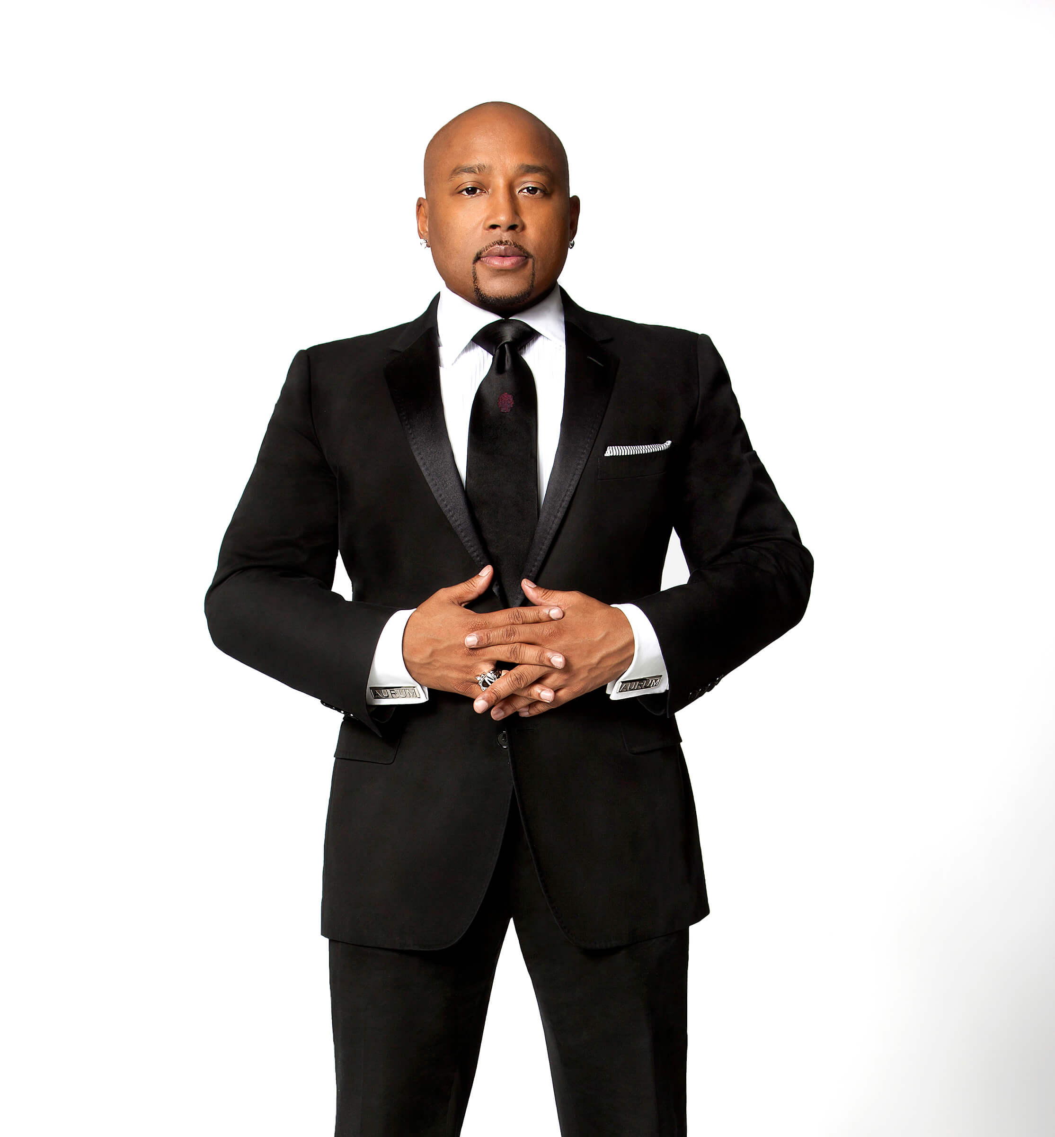
Notable figures, 10 through 12
10
11
12
Notes:
10. This Formula 1 driver was involved in a crash in 2001 which resulted in both legs being amputated. It was after this that he won four World Touring Car Championship (WTCC) victories and now focuses his sporting efforts on adapted cycling. He designed his only high-performance three-wheeled bicycle which he has ridden to victory, winning three Paralympic gold medals.
11. This woman is an American disability rights advocate, and the first deafblind graduate of Harvard Law School. She advocates for equal opportunities for people with disabilities. President Obama named her a White House Champion of Change. She received the Helen Keller Achievement Award, and a spot on Forbes 30 Under 30.
12. He is a famous American businessman, investor, television personality, author, and motivational speaker. He is best known as the founder, president, and CEO of FUBU clothing, and appears as an investor on a reality television series called Shark Tank. He is also quick to explain how dyslexia helped shape him into a successful entrepreneur.

Slide 22
TIME TO GRADE YOUR ROUND 2 ANSWERS!

Slide 23
Round 3:
Disability and The Media

Slide 24
It’s hard to find accurate, authentic and diverse representation of individuals with disabilities in the media.
The following clips are not representative of reality.

Slide 25
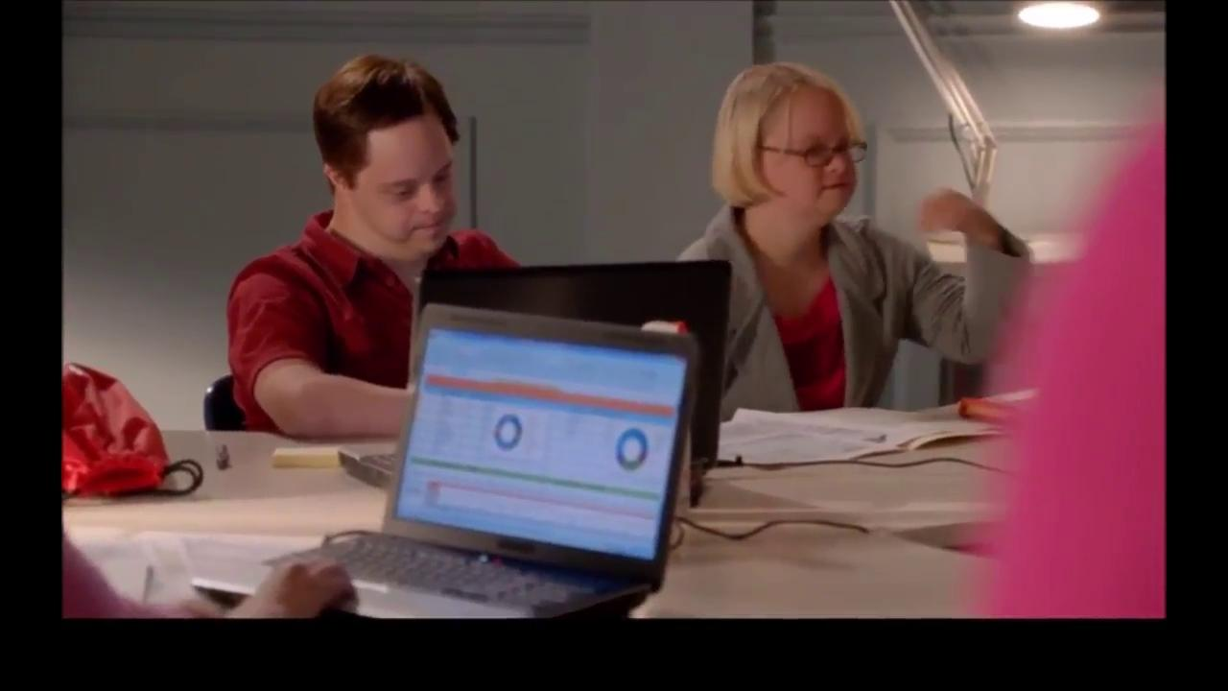
1.

Slide 26
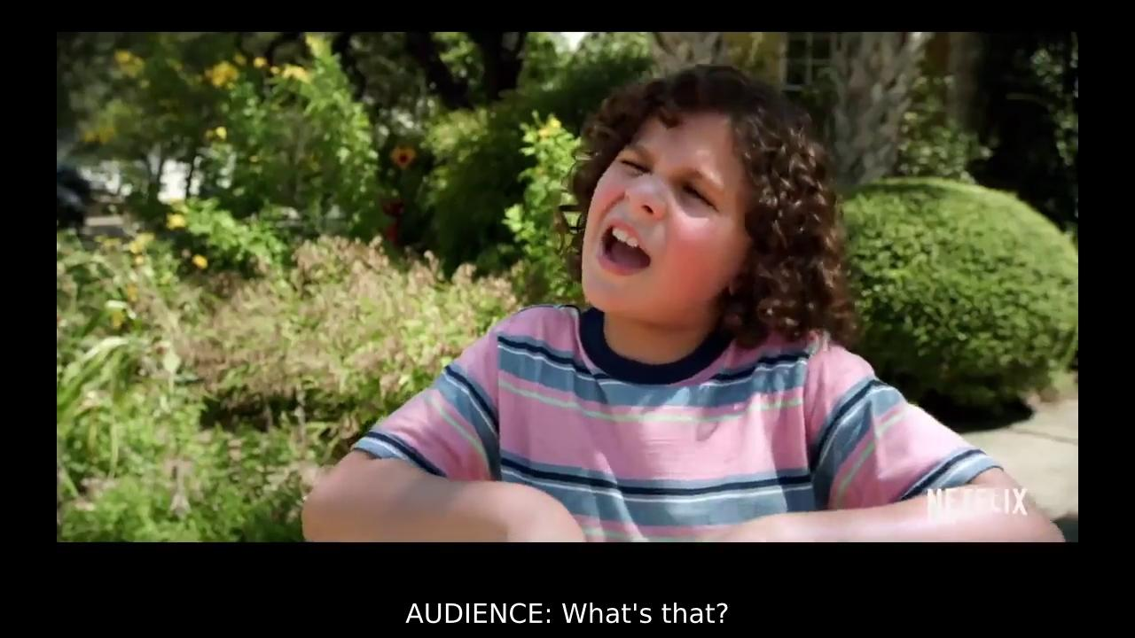
2.

Slide 27
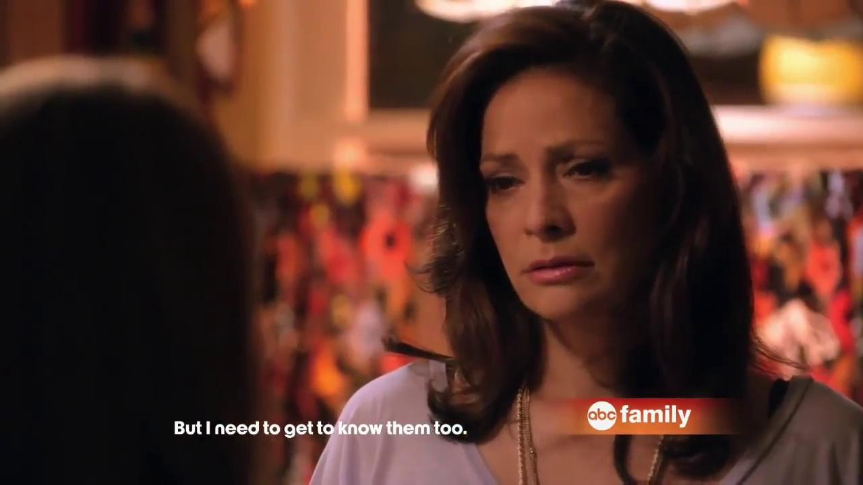
3.

Slide 28
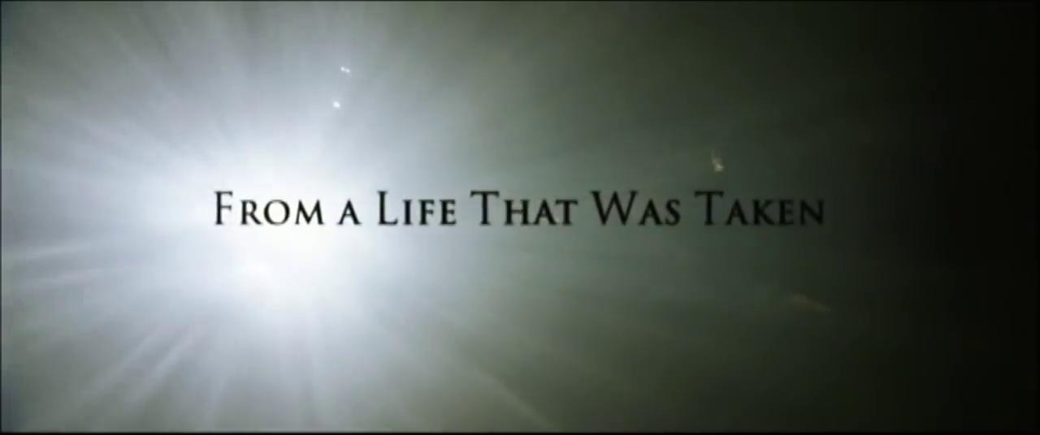
4.

Slide 29
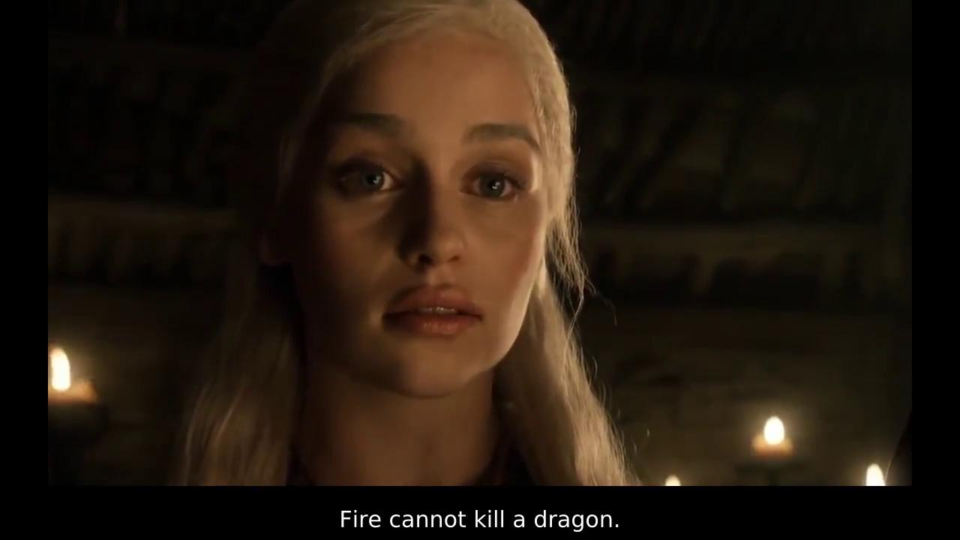
5.

Slide 30
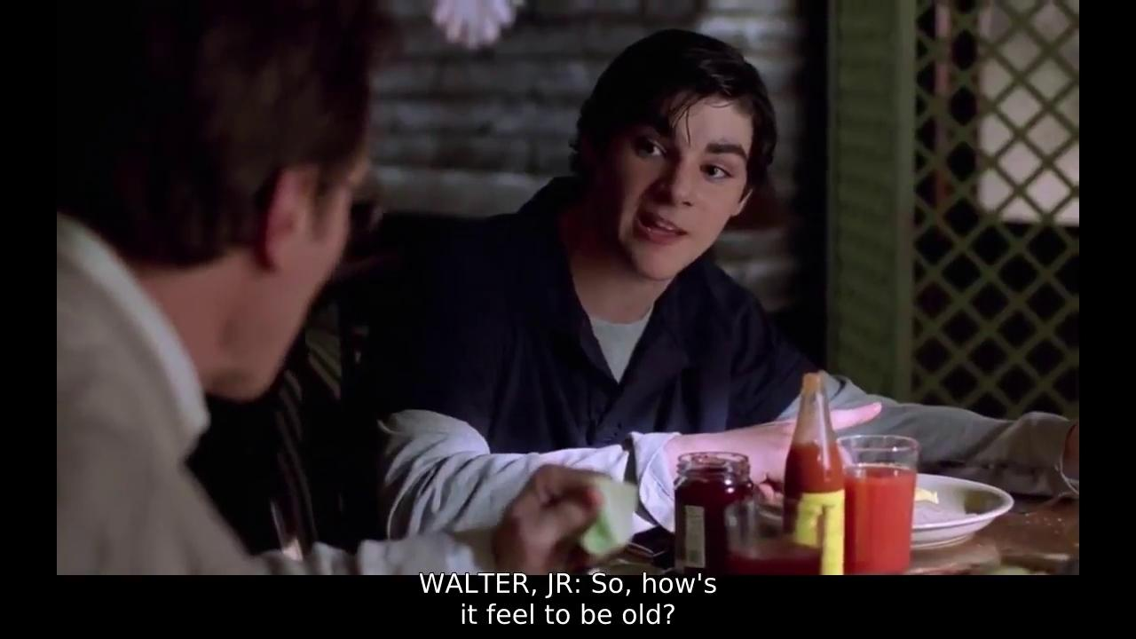
6.

Slide 31
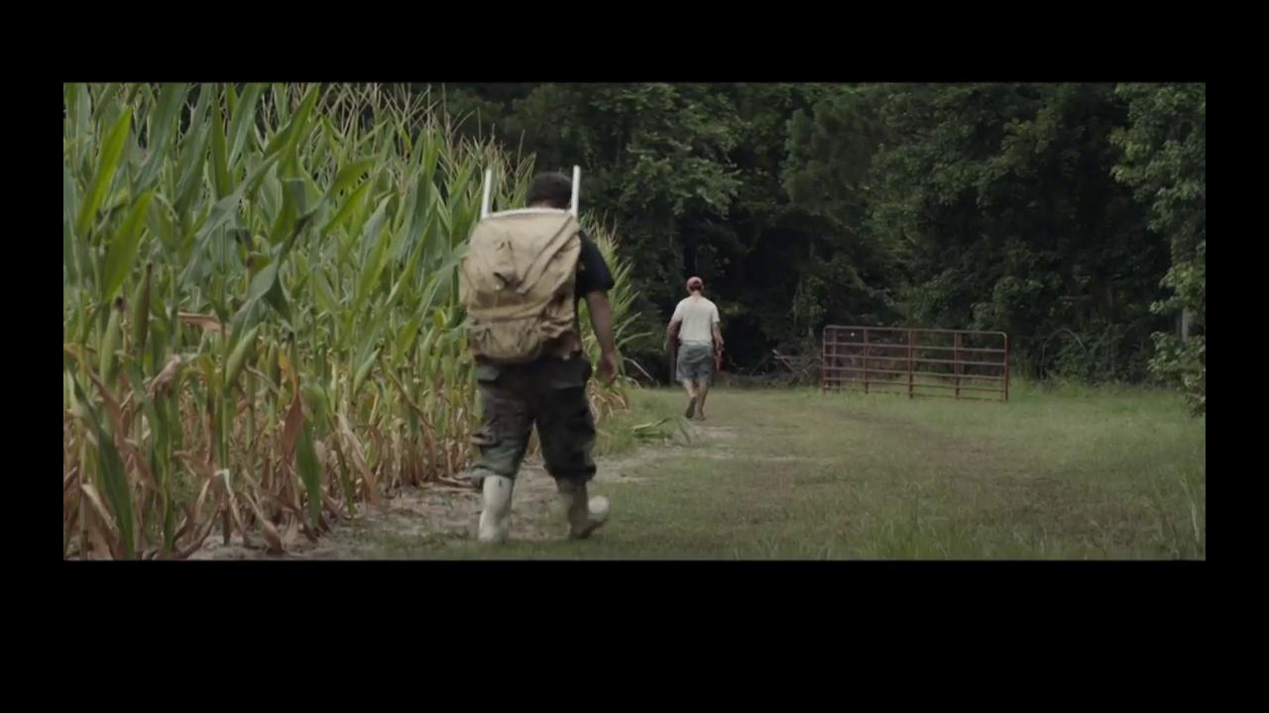
7.

Slide 32
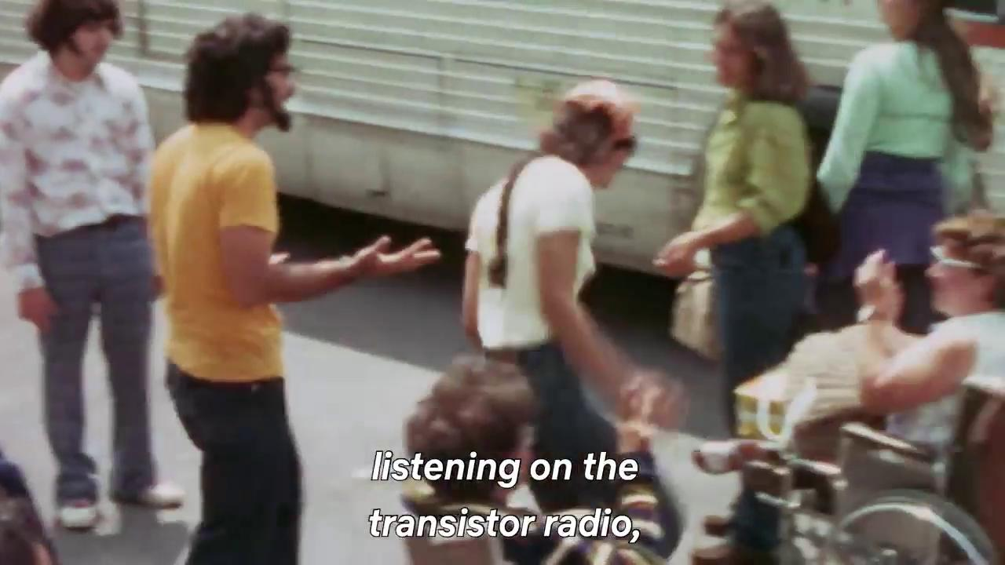
8.

Slide 33
The Disability Collection is one initiative that looks to increase representation of individuals with disabilities in the media.
Find out more at thedisabilitycollection.com

Slide 34
TIME TO GRADE YOUR ROUND 3 ANSWERS!

Slide 35
Round 4:
Digital Accessibility

Slide 36
WCAG is the acronym for industry standard guidelines used to assess digital accessibility. What does WCAG stand for?
World Council Accessibility Group
World Content Access Governance
Web Consortium Accessibility Guidelines
Web Content Accessibility Guidelines

Slide 37
2. According to WCAG 2.1 AA standards, what is the minimum color contrast ratio between foreground and background colors?

Slide 38
3. A screen reader is software often used by individuals who are blind or have low vision to access a computer, tablet or smartphone. Which one of the following is NOT a screen reader?
Voiceover
Siri
VoiceView
TalkBack
NVDA

Slide 39
4. Screen readers users rely on text descriptions that describe images. These descriptions are so common, that they have a name based on the HTML (hypertext markup language) code used to create them. What is the commonly used name for these text descriptions?

Slide 40
5. True or False?
Websites that pass through automated Accessibility Testing Tools with no flags or errors are pretty certain to be accessible to users with disabilities.

Slide 41
TIME TO GRADE YOUR ROUND 4 ANSWERS!

Slide 42
Round 5:
Advancing Accessibility in Society

Slide 43
This invention was designed to make public streets more accessible to wheelchair users and was first installed as early as the 1930s in the UK, and in the 1940s in the US. What is the name of this invention?

Slide 44
2. Tenji blocks are used in public spaces on sidewalks and train platforms to help guide individuals with visual impairments. They feature raised dots or bars, similar to Lego building blocks and alert people of what is ahead. Where were Tenji Blocks invented?

Slide 45
3. Which American sports tradition was invented to address players who were deaf and hard of hearing?
The American Football huddle
Referee hand signals
The scoreboard
Player numbers

Slide 46
4. For whom were long-play (LP) vinyl records originally intended?

Slide 47
5. Which technology company recently created a specially designed video game adaptive controller for people with disabilities?

Slide 48
TIME TO GRADE YOUR ROUND 5 ANSWERS!

Slide 49
Round 6:
Additional Questions Just For Fun

Slide 50
Teach Access is an organization that brings together industry, academia and advocacy groups to ensure students of technology learn accessible design principles. What two companies founded Teach Access?
Yahoo and Facebook
AOL and Google
Microsoft and Be My Eyes
Amazon and Apple

Slide 51
2. Verizon, Getty Images and the National Disability Leadership Alliance have partnered to create a radically new collection of stock images that break stereotypes and authentically portray people with disabilities in everyday life. What is this collection called?

Slide 52
3. What is a common coding technique that enables a switch or keyboard user who can’t use a mouse or trackpad, to move the keyboard focus directly to different areas of a web page without forcing them to press the tab key repeatedly.

Slide 53
4. Who or what inspired picture-based cash registers like those used at fast-food restaurants?
James J. Ritty
A person using Augmentative and Alternative Communication
National Cash Register Company
McDonald’s

Slide 54
5. What types of assistive technologies are most helpful for people who have dyslexia?

Slide 55
6. What assistive technology makes TV and video accessible for people who are blind or have low vision?

Slide 56

Who is the winner?

Slide 57
Thanks for playing!

